Slide 1
Market research
A brief overview of the restaurants in Los Angeles
The data was taken from open sources.
With the help of Python

Slide 2
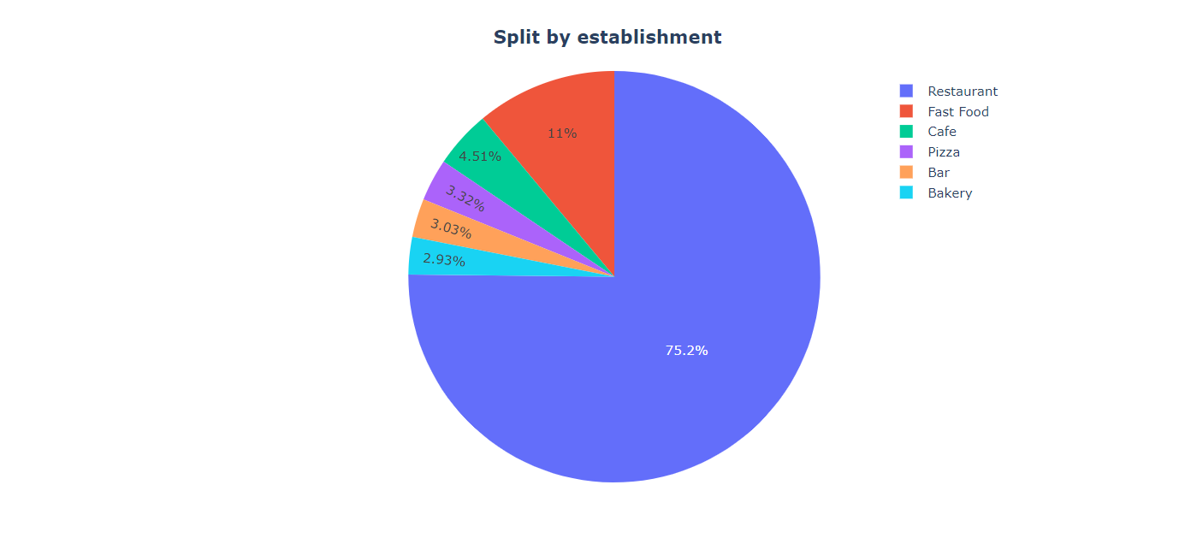
3/4 of objects are restaurants. Fast food takes 2nd place.

Slide 3
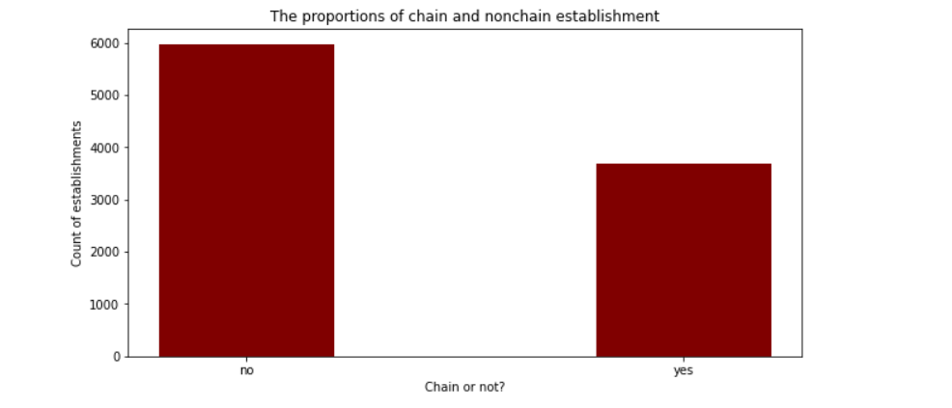
The amount of nonchain establishments prevails over the amount of chain establishments

Slide 4
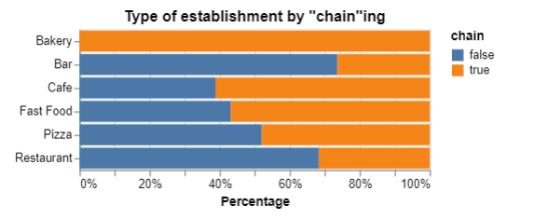
All bakeries are chain establishments, other have proportions.
For Cafe we see chain type prevails, for restaurants vice versa.

Slide 5
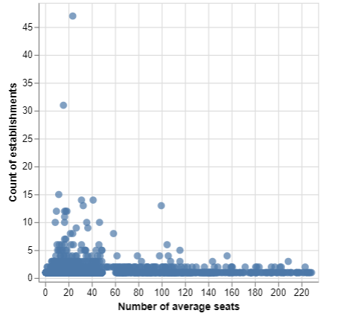
Average number of seats and count of establishments for chains only
From this graph, we can conclude that there is no correlation between the number of seats
and the number of establishments in the chains.

Slide 6
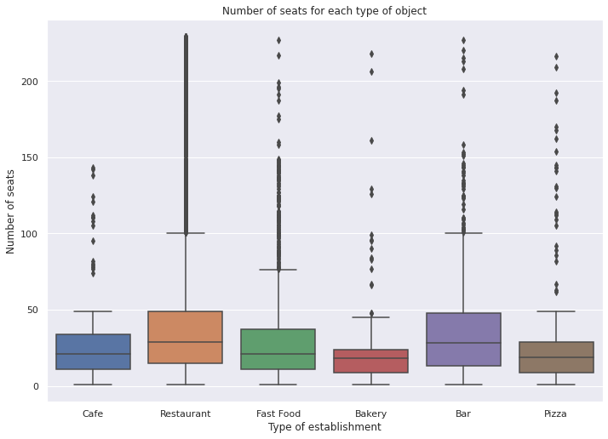
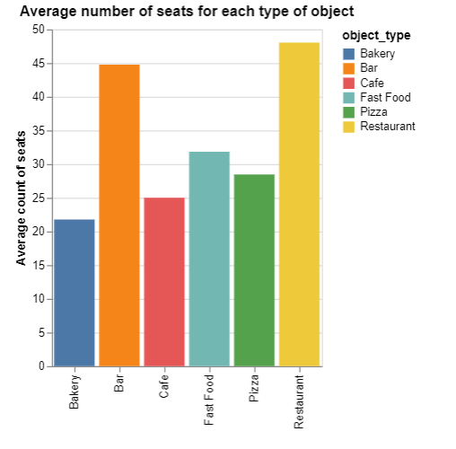
Bars and restaurants have the highest average seating capacity.
Smallest number of seats in bakeries

Slide 7
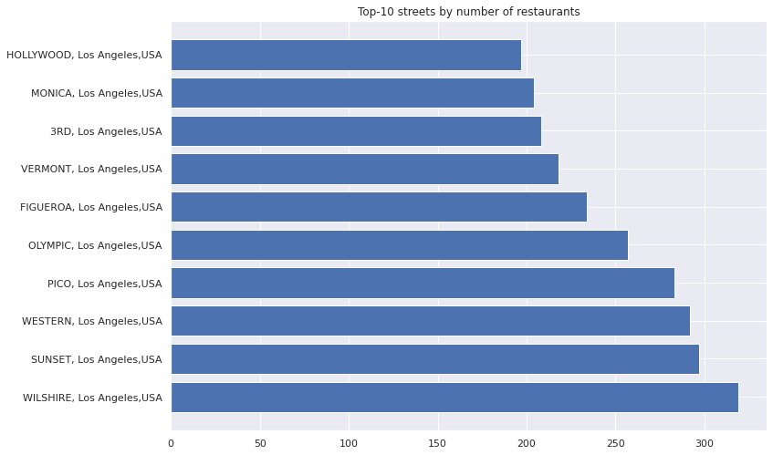
Here we see top-10 streets by number of restaurants

Slide 8
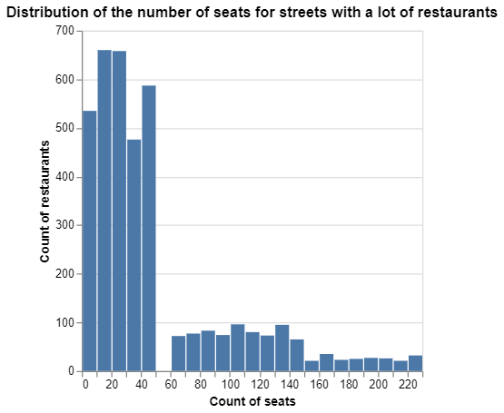
Most restaurants have less than 50 seats. So the graph is skewed to the right

Slide 9
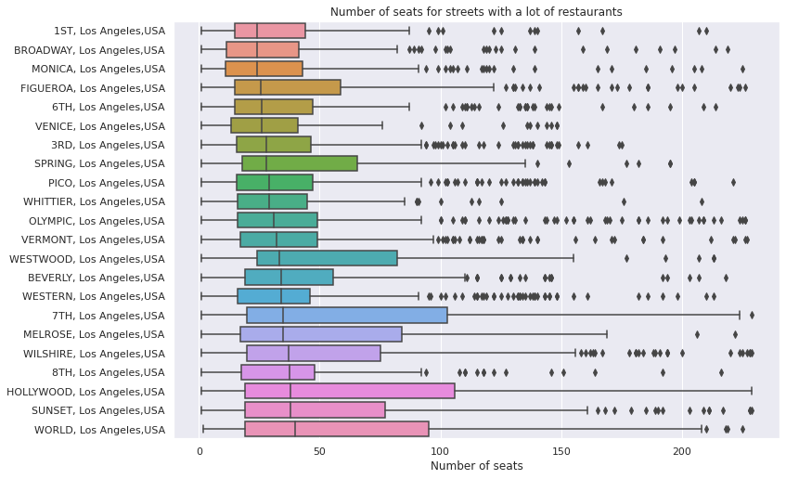
Here we see number of seats in restaurants on most popular streets
(streets with the most count of restaurant on it)

Slide 10
Conclusions
Restaurant is the most popular type of establishments (75.2%).
Count of non-chain establishments are dominated
We haven’t correlation between number of seats and count of establishments in chain
Average number of seats for restaurant the greatest comparing with other establishments (no surprise)
We have now graph with Top-10 streets by count of restaurants. But most of streets in LA have only 1 restaurant (80% of streets)
Most restaurants have less than 50 seats

Slide 11
Recommendation
To look for the cheapest rental on the most popular streets
The number of seats is up to 50

